Slide 1
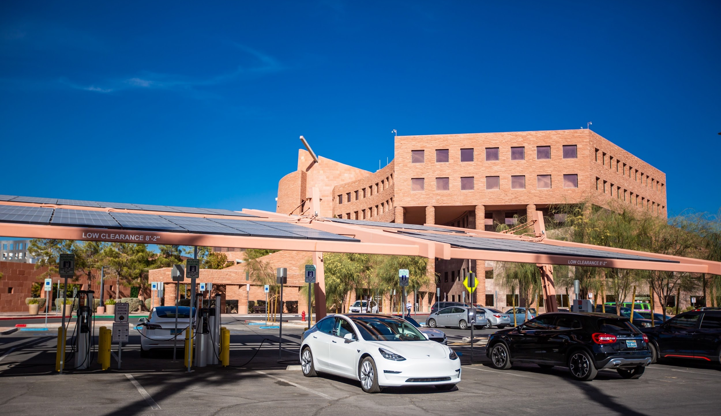

Clark County Transportation Electrification Working Group
Dec. 1, 2022

Slide 2

AGENDA
Model EV Charging Ordinance Comments Update
Regional Transportation Electrification Plan Review
Q&A: Public and Interested Parties
Next Steps
Ford F-150 Lightning

Slide 3

Questions?
Post questions in the chat or raise your hand.
Time reserved for Q&A and discussion.
Rivian R1T

Slide 4
MODEL EV CHARGING ORDINANCE COMMENTS
Marci Henson
Clark County

Slide 5
THANK YOU FOR YOUR COMMENTS
Caring, Helping & Restoring Lives
City of Henderson
City of Las Vegas
City of North Las Vegas
Clark County School District
Electrification Coalition
NAIOP
Nevada Conservation League
NV Resorts Association
Southern Nevada Home Builders Association
SWEEP
Western Resource Advocates
Tesla
SNWA

Slide 6
REVISIONS
Simplified calculation and made targeted changes to % requirements
Added waiver & alternative compliance allowances
Clarified accessibility requirements
Deleted applicability to substantial changes that trigger additional parking requirements.
Specified applicability in Table 30.01-4: Minimum Required Off-Street Parking and Stacking Spaces in County Code

Slide 7
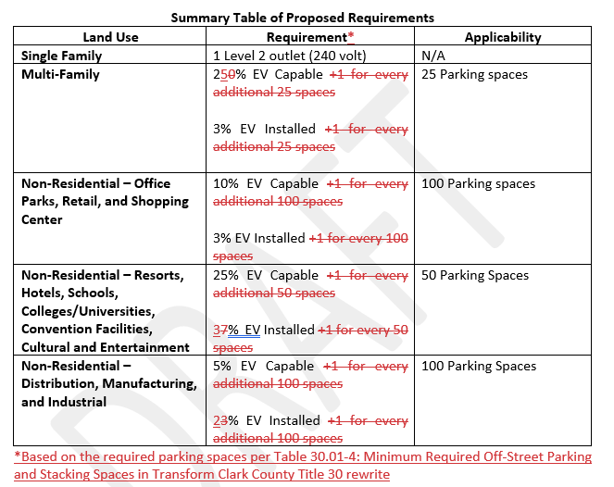
REVISIONS

Slide 8
PROPOSED FINAL
Land Use | Requirement* | Applicability
Single Family | 1 Level 2 outlet (240 volt) | N/A
Multi-Family | 25% EV Capable 3% EV Installed | 25 Parking spaces
Non-Residential – Office Parks, Retail, and Shopping Center | 10% EV Capable 3% EV Installed | 100 Parking spaces
Non-Residential – Resorts, Hotels, Schools, Colleges/Universities, Convention Facilities, Cultural and Entertainment | 25% EV Capable 3% EV Installed | 50 Parking Spaces
Non-Residential – Distribution, Manufacturing, and Industrial | 5% EV Capable 2% EV Installed | 100 Parking Spaces
Summary of Changes
SF – No change
Eliminated all +1 requirements
MF – EV capable increased from 20% to 25%
Non-residential resorts, hotels… – EV installed from 7% to 3%
Non-residential – distribution…EV installed from 3% to 2%
Added Public/Gov applicability – keeping in mind approved per plans

Slide 9
CALC EXAMPLES
Multifamily Example
Min. Required Parking Spaces: 350 spaces; EV infrastructure required? Yes (25+ spaces)
EV Capable Spaces 25% x 350 = 88 spaces
EV Installed Spaces 3% x 350 = 11 spaces
Office Park Example
Min. Required Parking Spaces: 200; EV infrastructure required? Yes (100 + parking spaces)
EV Capable Spaces 10% x 200 Spaces = 20 spaces
EV Installed Spaces 3% x 200 spaces = 6 spaces
Hotel Example
Min. Required Parking Spaces: 1050; EV infrastructure required? Yes (50 + parking spaces)
EV Capable Spaces 25% x 1050 Spaces = 262 spaces
EV Installed Spaces 3% x 1050 spaces = 31.5 spaces
Distribution Warehouse Example
Min. Required Parking Spaces: 500; EV infrastructure required? Yes (100 + parking spaces)
EV Capable Spaces 5% x 500 Spaces = 25 spaces
EV Installed Spaces 2% x 00 spaces = 10 spaces

Slide 10
PROPOSED FINAL
Applicability
  Ordinance requirements apply to new development.
General Infrastructure Requirements
  EV Capable – panel capacity plus conduit to parking space
  EV Charging Installed – EV charging station installed in parking space
Number of Spaces
  Parking requirements are intended to provide minimum standards.
  EV capable and EV installed parking spaces count towards minimum parking space requirements.

Slide 11
PROPOSED FINAL
Location
    Placement of EV capable and EV installed parking spaces determined by the developer.
Accessibility
  A minimum of one (1) EV installed parking space must be located adjacent to an ADA designated space to provide access to the charging station. The EV installed space should have all relevant parts located within accessible each and free of barriers to use by the accessible space. One (1) additional EV installed parking space must be located adjacent to an ADA accessible space for every 50 required EV installed parking spaces.
Signage
  Each EV installed space shall be reserved and designated as EV parking.

Slide 12
PROPOSED FINAL
Waivers
  The Board may grant a waiver of development standards according to the procedures outline in Section---Waiver of Development Standards.
Alternatives to Compliance
The Director may approve an alternative EV infrastructure plan per the procedures listed in S---.

Slide 13
CLARIFICATIONS
Public/Government facilities – approved per plans
Compliance & Enforcement – County’s approach will be to ensure compliance during plans submittal at the time of land use approval & building permit inspection process
Applicability – Requirements for EV infrastructure are triggered based a certain # of parking spaces being required.
  Ex. Multifamily Development – Applicability is trigger at 25 or more spaces
    Project #1 : 22 parking spaces are required per code; EV infrastructure requirement does not apply; essentially exempt
    Project #2: 150 parking spaces are required per code; EV infrastructure requirement applies
Electrical and building code requirements will be addressed in the building code; coordination is occurring, but will only occur after BCC elects to provide staff direction
If BCC directs staff to move forward, model ordinance will be incorporated into Transform Clark County Title 30 rewrite; development standards draft available now.

Slide 14
CLARK COUNTY REGIONAL TE STRATEGY
April Bolduc
S Curve Strategies

Slide 15
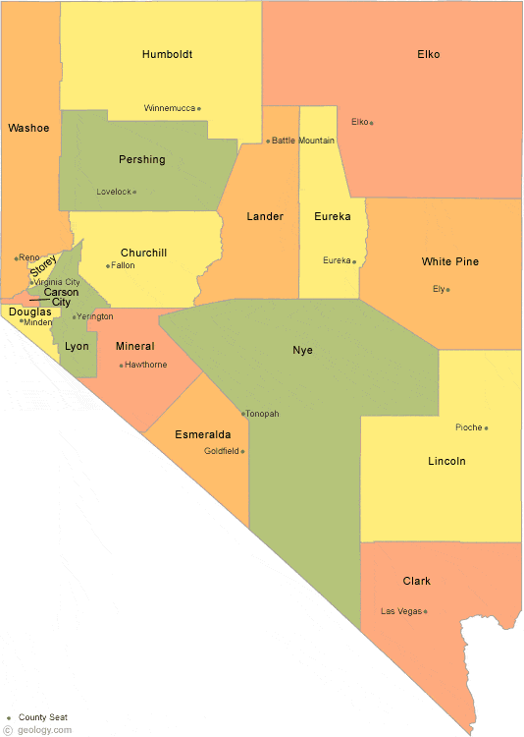
TE STRATEGY RECOMMENDATIONS
Lay the groundwork to rapidly accelerate EV adoption in the Clark County region (COMPLETE)
Current and future EV adoption projections to meet net zero by 2050 (COMPLETE)
Projections for EV charging to meet EV adoption goals (COMPLETE)
Existing EV infrastructure, development needs, and installation planning (COMPLETE)
Elevate the Working Group transportation electrification acumen (COMPLETE)
A focus on Clark County.

Slide 16
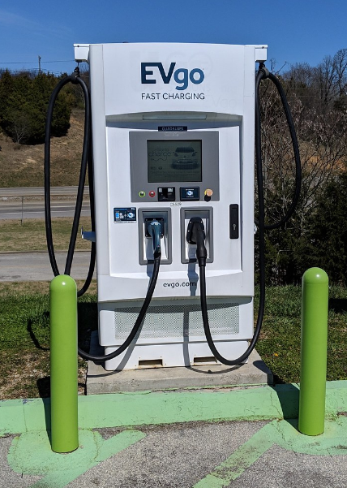
TE STRATEGY RECOMMENDATIONS CONT’D
Draft a model EV infrastructure ordinance – draft and comments received (COMPLETE)
Understand PUCN TE efforts – Overviews by PUCN and NV Energy, stakeholders encouraged to provide comments to proceedings (COMPLETE)
Economic and workforce development efforts and opportunities (COMPLETE)
Government agencies determine where EV goals housed and by who (COMPLETE)
Launch Clark County Clean Cities Coalition (COMPLETE)

Slide 17


TE STRATEGY CONTENTS
Current TE policies, incentives, and plans
  State
  Local
EV adoption baseline for Clark County jurisdictions
Barriers to EV adoption
Recommendations
All comments and letters received from members and interested parties.

Slide 18
TEWG NEXT STEPS

Slide 19

NEXT STEPS
Review Regional Transportation Electrification Strategy
  Emailed following meeting
  Due Dec. 15, 2022
  Word doc to track changes
  Will go to design with charts, etc., once feedback received
Model Ordinance
  Presented to BCC for staff direction 12/20
  If directed to proceed, will be incorporated into Transform Clark County Title 30 rewrite

Slide 20
THANK YOU MEMBERS
Marci Henson
Clark County

Slide 21

THANK YOU MEMBERS!
CHISPA
City of Boulder City
City of Henderson
City of Las Vegas
City of North Las Vegas
Clark County
Clark County School District
NAIOP
NV Climate Initiative
NV Department of Transportation
NV Division of Environmental Protection
NV Energy
NV Governor’s Office of Energy
NV Resort Association
NV State Apartment Association
Regional Transportation Commission
Southern NV Water Authority
Southern NV Home Builders Association
Southwest Energy Efficiency Project
The Electrification Coalition
Western Resources Advocates

Slide 22
Thank you
Questions?
Marci Henson, Clark County, mhenson@clarkcountynv.gov
April Bolduc, S Curve Strategies, abolduc@scurvestrategies.com

